Slide 1
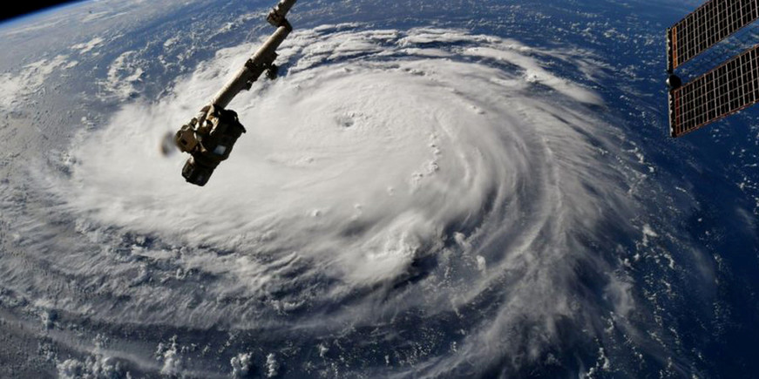

Project 1 – Effects of Hurricanes
Phoebe Burns, Michael Chrzanowski, Workineh Shunane,
Naima Kittrell, Aan Atta

Slide 2
Introduction
We came into this project looking to find answers on the type of effects that natural disasters, specifically hurricanes, can have on the areas that they so often devastate. We dove deeper into specific hurricanes from the past where we focused on the effects that these storms would have on the economy and population of the areas that were hit the hardest for each storm.
We were curious to see if these areas would see a drastic change in the pricing of housing in the area, or if perhaps we would see a change in population over time with people fleeing these dangerous areas in fear of storms returning in the future.

Slide 3
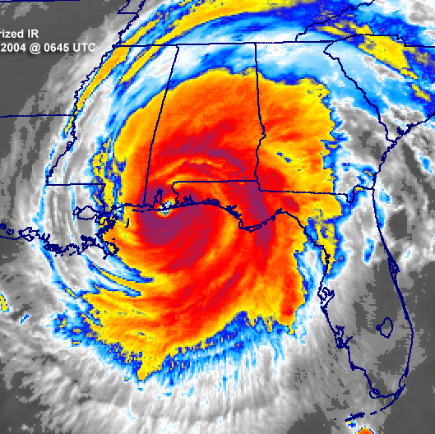
Hurricane Ivan
First US landfall on 9/16/2004 near Gulf Shores/Florida Panhandle
Category 5 Hurricane (Category 3 upon US landfall)
Peak wind speed 168mph
$26.1 billion in damage
Area Researched: Pensacola, FL

Slide 4
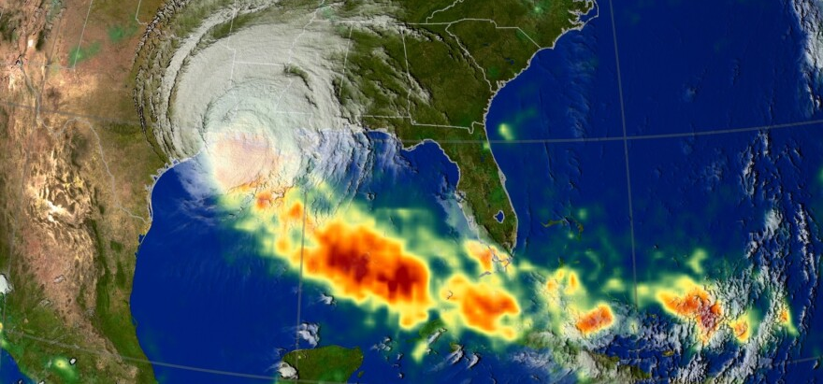
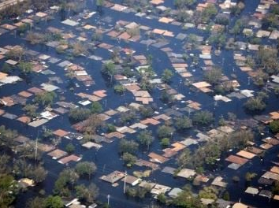
Hurricane Rita
First US Landfall 9/24/2005 on Texas/Louisiana border
Rita was the most intense tropical cyclone on record in the Gulf of Mexico and the fourth-most intense Atlantic hurricane ever recorded.
Category 5 hurricane (Category 3 on landfall)
Peak 177mph winds; $18.5 billion in damage
Area Researched: Houston, TX

Slide 5
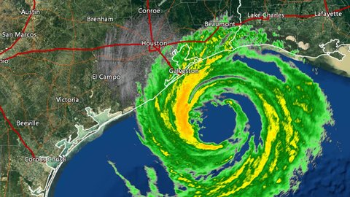
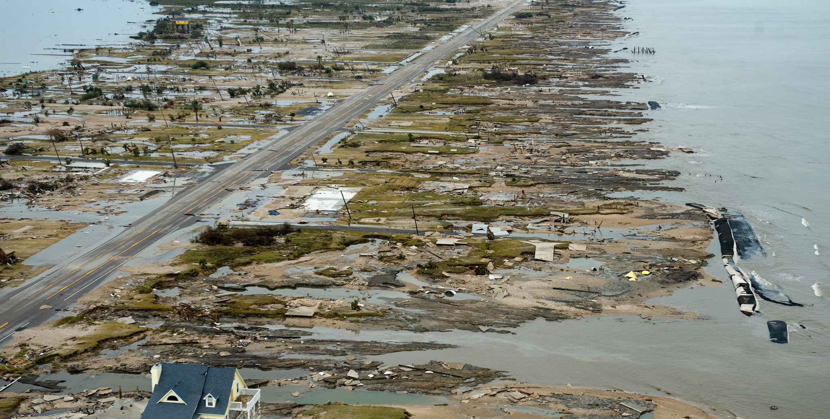
Hurricane Ike
First US landfall 9/13/2008 in Galveston, TX
Category 4 hurricane (Category 2 on landfall)
Peak wind speed 143 mph
$38 billion in damage
Area Researched: Galveston, TX

Slide 6
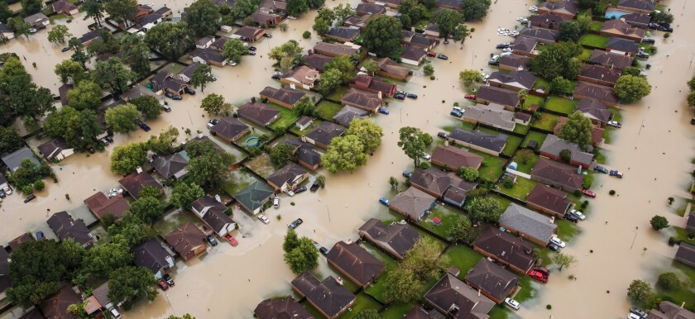
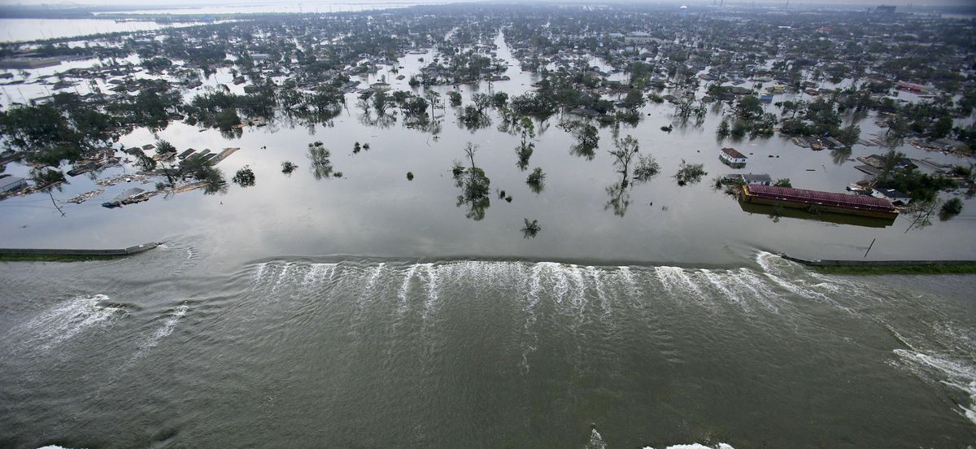
Hurricane Katrina
Made US landfall near New Orleans, LA on 8/29/2005
Despite being only the third most powerful storm of the 2005 hurricane season, a failure in the levee system caused Katrina to be among the worst natural disasters in the history of the United States.
Katrina peaked as a Category 5, but made landfall as a Category 3.
175mph winds; $125 billion in damage (tied as costliest tropical cyclone on record)
1,833 fatalities
Area Researched: New Orleans, LA

Slide 7
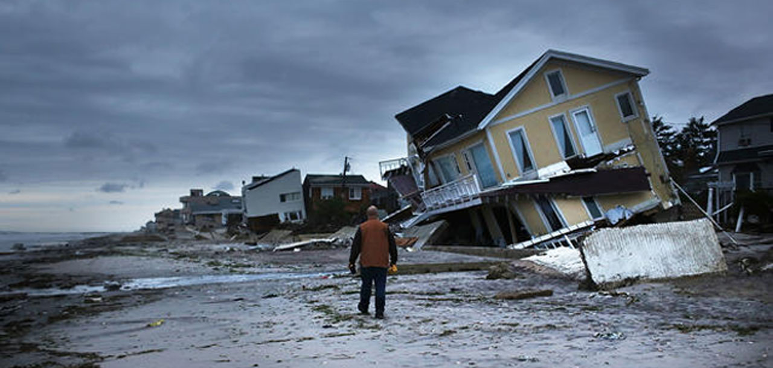
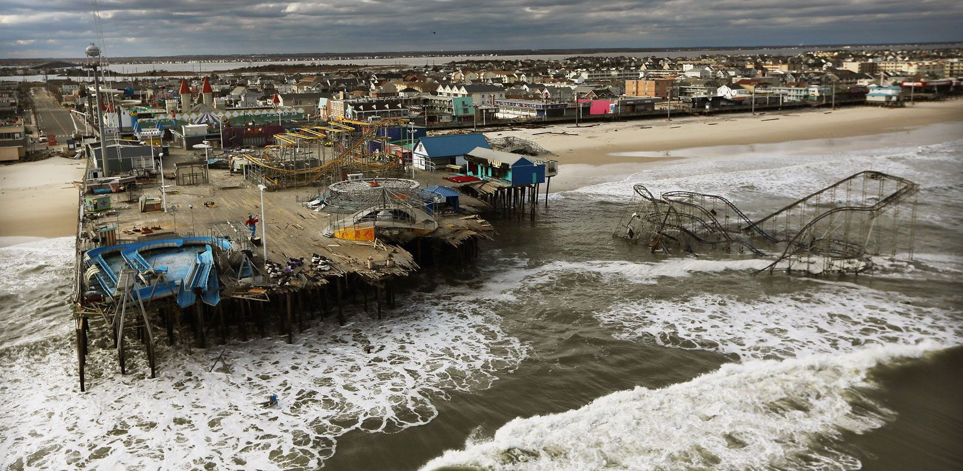
Hurricane Sandy
Made US landfall on 10/29/2012 near Atlantic City, NJ
The deadliest, most destructive, and strongest hurricane of the 2012 season, Sandy was also the 6th costliest hurricane in US history.
Wind speed 115mph; almost $70 billion in damage
Category 3 hurricane that was reclassified as a “superstorm” just before landfall.
Area Researched: Cape May County, NJ

Slide 8

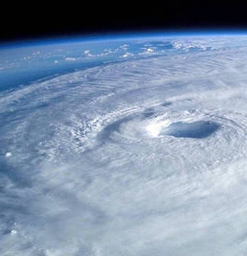
Data
We used the St. Louis FED as our data source. We were able to pull data directly from here which we used to create our graphs and draw conclusions for the questions we came in with using the information we obtained from the site.
We focused on 6 main categories to analyze the change and effects that could be caused in the economy/populations from these storms: Population, Unemployment Rate, Median Household Income, Real GDP, Housing Price Index, and New Authorized Private Housing Structures.
We identified and evaluated what these statistics looked like in the affected areas in the preceding 4 years prior to the hurricane making landfall, as well as both the immediate and long term effects of the storm.
Main questions we were looking to have answered:
Do hurricanes have a serious impact on the economy of the affected areas?
Is there a correlation on the housing market prices after these storms leave behind billions in damage?
Is there an obvious decrease in population after these disasters due to residents relocating to less affected areas?

Slide 9

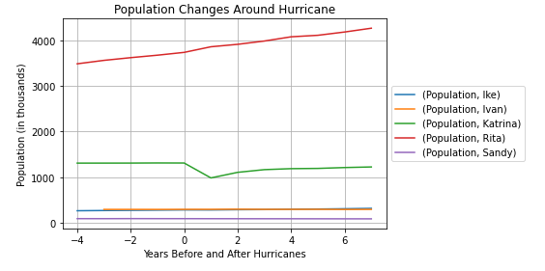
Population
When analyzing the data we gathered for the effects on the population, the conclusion we came to is that the effect wasn’t as great as we thought.
As you can see, the only noticeable change in population due to the destruction of the storm was during Hurricane Katrina, likely due to the immense amount of flooding that took place.
There was a decrease of more than 300,000 people after Hurricane Katrina ravaged through southern Louisiana, including a large effect on the city of New Orleans.
The population of New Orleans fell from over 484k before Katrina (April 2000) to an estimated 230k after Katrina (July 2006)—a loss of over half of the city's population

Slide 10
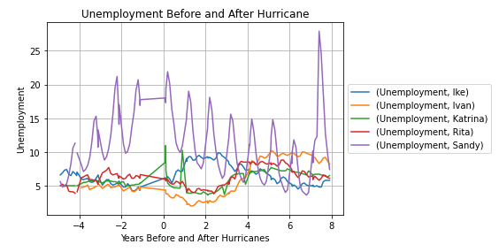
Unemployment Rate
When analyzing the effect on the unemployment rate after the storms, you can see that effect was a little different depending on the storm. We can see that both Katrina and Sandy seemed to have caused an immediate spike in unemployment during the immediate aftermath of the storms, followed by a sharp decrease in unemployment rate within the first year after the storm.
Both Rita and Ivan seemed to follow similar trajectories in this area, where there was a decrease in unemployment rate after the storm and the immediate years following. However, Ike had a rise in unemployment during the aftermath, which could have something to do with when it took place in 2008.

Slide 11
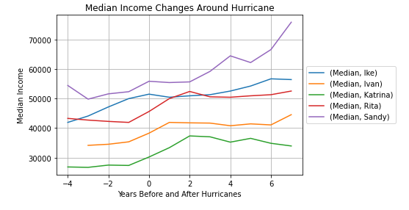
Median Household Income
When analyzing these results it was tough to pinpoint if there was any direct effect on the household income after the storms hit. We can see that for Rita, Ivan, and Katrina, that there was actually a rise in income during the first 1-2 years after the storm. There was no real effect for Ike and the rise for Sandy came years down the line and could be contributed to other causes.
We were curious to see if there would perhaps be an even lower income in some areas due to perhaps a higher poverty level due to such devastation, but that was not the case.

Slide 12

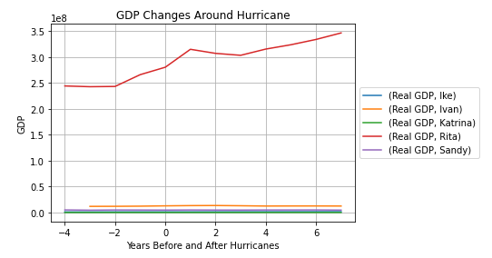
Real GDP
Real GDP is a macroeconomic statistic that measures the value of the goods and services produced by an economy in a specific period, adjusted for inflation.
As shown in the chart, there was no real correlation whatsoever to the damage that a hurricane causes to the GDP of a particular area affected by the storm.
We can point to Rita, which actually shows a continuous increase even during the immediate aftermath of the storm, with the GDP rising by roughly 1 million after 1 year.
The other 4 storms affected areas maintained the same GDP that they had in the years leading up to the storm as they did in the years following, demonstrated on the bottom of the chart.

Slide 13
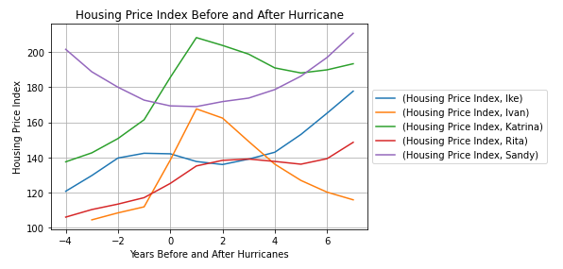
Housing Price Index
Housing Price Index is a tool that measures changes in single-family home prices across a designated market.
In analyzing this piece of data, we can see a rather consistent correlation in the Housing Price Index in storm affected areas after the hurricane. In the other 4 storms, besides Ike, we can see a rather immediate increase in the price index of houses in the first year after the storm, specifically Katrina, Ivan, and Rita.
Although it took a little longer, we can see that the Jersey Shore eventually recovered and climbed back to the levels that it had previously been at in the years prior to the devastation of Sandy.

Slide 14
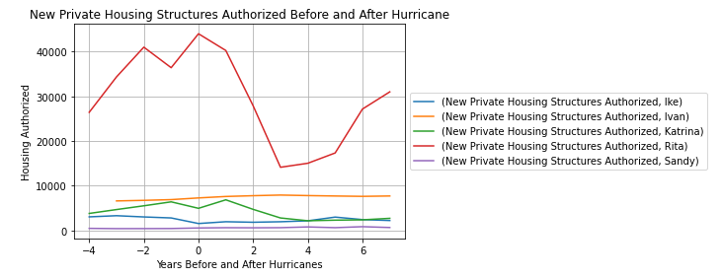
New Authorized Private Housing Structures
As we were interested in the price of housing after the storm, we were also curious of the rate at which they were being built. The only storm that seemed to provide significant results in this regard was Rita, where we can see a steep decline in the amount of new private structures in the first 3 years following the storm, before a progressive rise.
There was a slight increase in authorized structures after Katrina before it tailed back off, but there’s nothing that we can point to as a significant and direct effect of the storm damage that took place for the other affected areas as a whole.

Slide 15
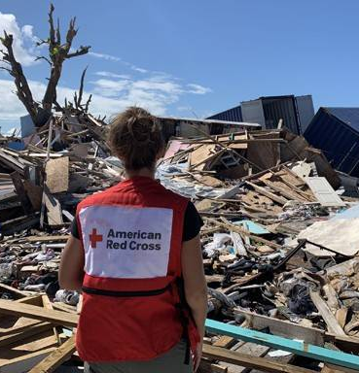
Conclusion
After digging into the data and researching the questions we came in with, we were able to draw a few conclusions from this project. The main thing is that the effect that these storms have on the economy and population of these affected areas isn’t as drastic as we had thought coming in. While these storms certainly cause havoc and negatively impact a lot of individual lives and families, the data that we gathered doesn’t show a huge impact on the overall economy.
The biggest effects we could point to was the steep population decrease in New Orleans following Katrina, though the population has started to climb back to where it was before the storm in recent years. We could also see a correlation in the rise in the price of homes in the affected areas in immediate years following the storms.
Hurricanes are very common and “Hurricane Season” in the US is right around August-September every year. Despite the danger these storms possess, it seems that residency is rather consistent despite the yearly threat.
Ultimately, while these storms certainly cause an immediate shock to the areas, it seems that there are no great long term affects that they leave behind economically or in population, as the statistics usually return to the norm, if they were ever really drastically affected at all.

